Slide 1
In-Browser Raster Data Processing

Slide 2
Introduction
What is raster data?
What is Web Assembly(Wasm)?
Why use Wasm for this project?

Slide 3
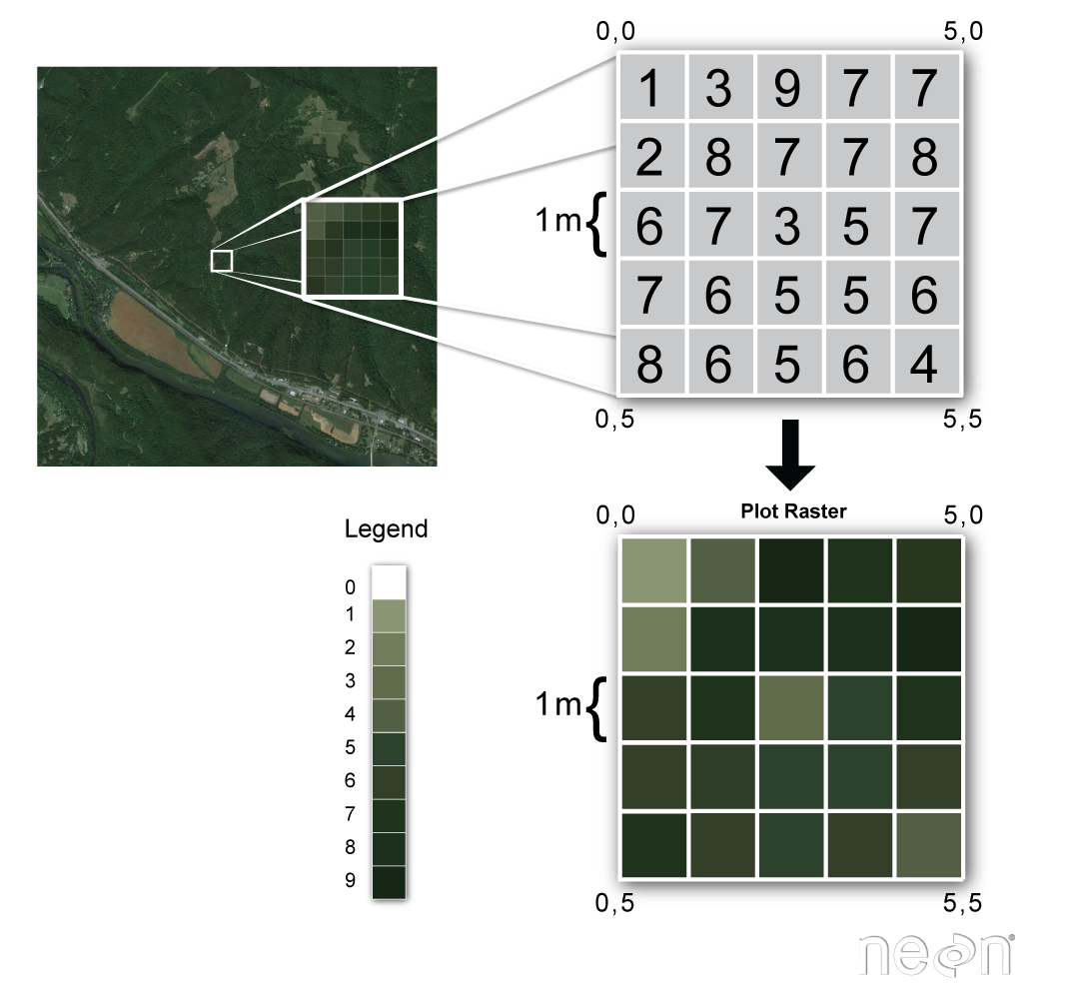
Raster Data
Data from satellites.
Type of spatial data.
Represented as multi-dimensional arrays.

Slide 4
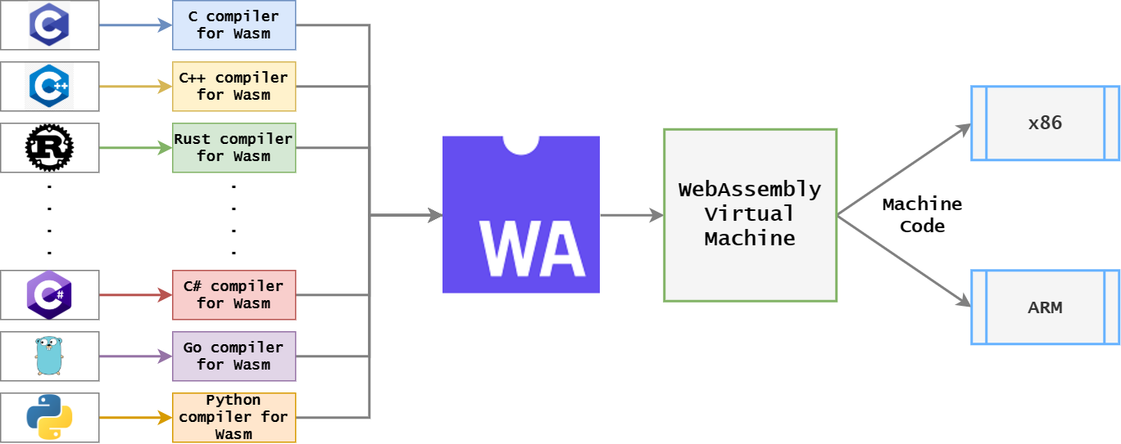
Web Assembly
It is a byte code instruction format.
Linked together with JS and HTML.
Can be run on modern browser.
Achieves near native performance.
Polyglot.

Slide 5
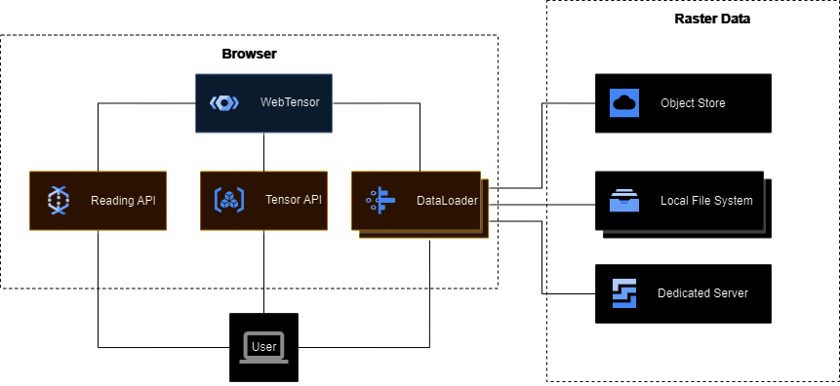
Implementation
Implement a data loader.
Implement the raster data processing module.
User Interface for visualization.

Slide 6
Data Loader
File Path or URL
Coordinate Reference System(CRS)
Spatial Extent
Band Selection
Memory Size
Error Handling

Slide 7
Raster Data Processing
Aggregations

Slide 8

User Interface
Histograms
Mix and Max values

Slide 9



Tools
Emscripten for C/C++.
Pyodide for python.
Geospatial Data Abstraction Library(GDAL).
rasterio, rioxarray – Python Packages.
gdal3.js – GDAL and related tools.

Slide 10
Benchmarking
Implement the same program without wasm.
Compare and measure the performance.

Slide 11
References
[1] L. F. Naumann, “WebTensor: Towards high-performance raster data analysis in the browser,” in Datenbanksysteme für Business, Technologie und Web (BTW 2023), 20. Fachtagung des GIFachbereichs „Datenbanken und Informationssysteme" (DBIS), 06.-10, März 2023, Dresden, Germany, Proceedings, vol. P-331 of LNI, pp. 1083–1089, Gesellschaft für Informatik e.V., 2023.

Slide 12
Thank you!
vishnu-raj.cherukudi-mattuvayil@tu-ilmenau.de | www.tu-ilmenau.de

